Slide 1
The Human experience of death and dying

Slide 2
Four Courners: A good Death
The experience of Palliative care
Four Corners documents the last days of life of four people who are facing death but are determined to die a "good death".
https://clickv.ie/w/8WMn

Slide 3
What is your experience of death?
Someone’s immanent death being reported
Someone’s death being reported
Someone personally close who is terminal or has died
Visiting someone Palliative care
Attending a funeral
Remembering a loved one

Slide 4
The Denial of Death – Earnst Becker
Dread
Fear
Anguish
Physical limitation
Mortality
Fragility
Stomach

Slide 5
Mysterium Mortis: The Moment of Truth - Laidislaus Boros
The reality of death is the ultimate moment of self-transcendence
An awakening in the human spirit
Points to ultimate meaning
Guide to truth, goodness and beauty
Head

Slide 6
Touching on the Infinite – Tony Kelly
Transcendence is found in HOPe
Hope is in the paschal mystery of the death and resurrection of jesus
Jesus shows the way of hope in a life of fullness with the father
Heart

Slide 7
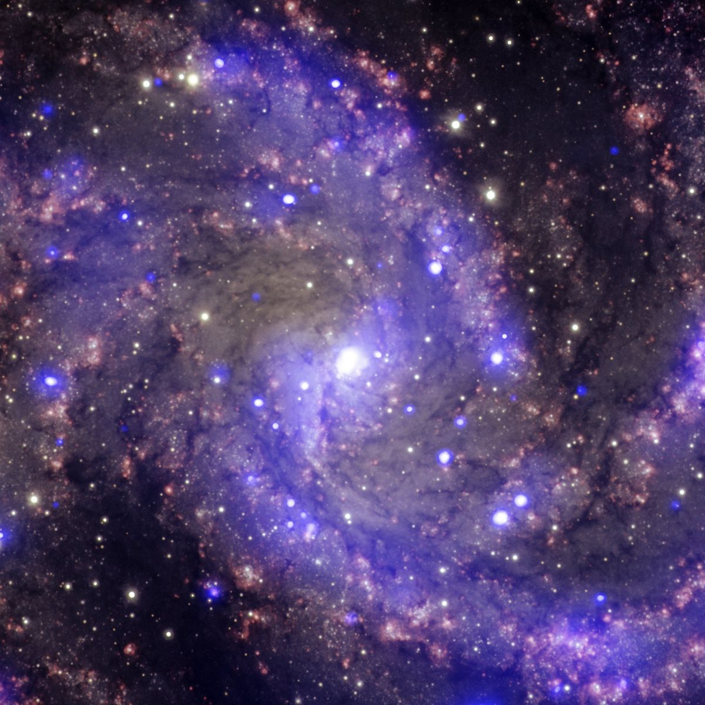
Where are you feeling the human experience of death?
Stomach
Head
heart

Slide 8
On death and Dying - Elisabeth Kübler-Ross
American-Swiss psychiatrist
https://youtu.be/Q2BJsOQypuw

Slide 9
Stages of dying (DABDA)
Denial
Anger
Bargaining
Depression
Acceptance

